Slide 1
Student Grade
Management System
shuaib Ahmed
Ahmed Ismail
Nabidul Huda
Kaung Thiha
Mohamed Irham

Slide 2
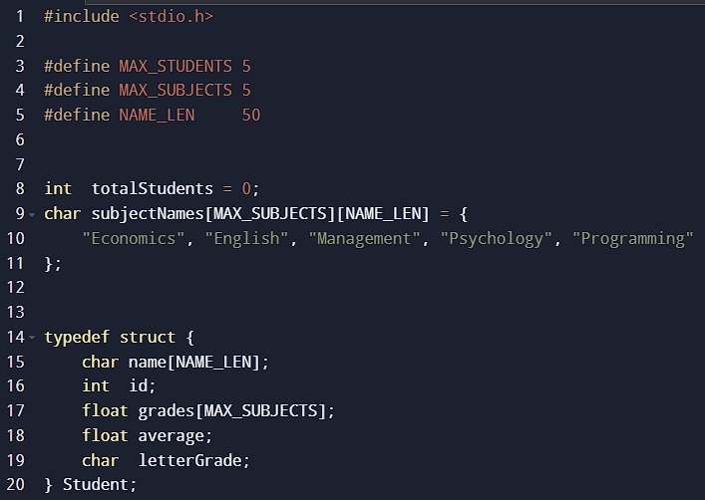
program structure & data definitions

Slide 3
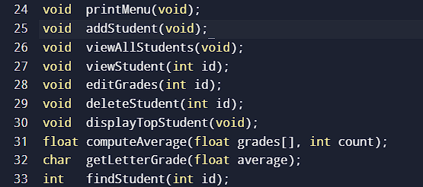
Function declarations

Slide 4
addStudent() — Adding a New Student
addStudent()
①
Capacity check
if (totalStudents >= MAX_STUDENTS)
return; // full
s.id = totalStudents + 26101000;
scanf(" %[^\n]", s.name);
for (i = 0; i < MAX_SUBJECTS; i++) {
scanf("%f", &grade);
if (grade < 0) grade = 0;
if (grade > 100) grade = 100;
s.grades[i] = grade;
}
s.average = computeAverage(...);
s.letterGrade = getLetterGrade(...);
Stops if 5 students already stored
②
Auto ID
id = totalStudents + 26101000
③
Name input
scanf(" %[^\n]") reads names with spaces
④
Grade clamping
Forces every grade into 0–100 range
⑤
Auto calculation
Calls computeAverage() & getLetterGrade()

Slide 5
viewStudent() & findStudent() — Lookup
findStudent(id)
How the lookup works:
for (i = 0; i < totalStudents; i++) {
if (students[i].id == id)
return i; // array index
}
return -1; // not found
findStudent() scans the array linearly, comparing each student's id to the target.
Returns the array index (0–4) on a match, or -1 if no student has that ID.
viewStudent(id)
viewStudent() calls findStudent() first — if index is -1 it prints an error and stops.
int idx = findStudent(id);
if (idx == -1) { // not found msg }
// print all 5 subject grades
// print average & letter grade
When found, it prints each of the 5 subject grades, then the computed average and letter grade.

Slide 6
editGrades() & deleteStudent() — Modify
editGrades(id)
deleteStudent(id)
idx = findStudent(id);
for (i = 0; i < MAX_SUBJECTS; i++) {
scanf("%f", &grade);
// clamp 0–100
students[idx].grades[i] = grade;
}
students[idx].average =
computeAverage(...);
students[idx].letterGrade =
getLetterGrade(...);
idx = findStudent(id);
// shift array left
for (i = idx; i < totalStudents-1; i++) {
students[i] = students[i+1];
}
totalStudents--; First, the program finds the student index using findStudent(id).
After deletion, all remaining students are shifted one position to the left.
This removes the empty gap in the array.
Finally, totalStudents is reduced by 1.
First, the program searches for the student using findStudent(id).
It asks the user to re-enter all subject grades.
The new grades are stored in the array.
Then the program automatically recalculates: Average
Both functions call findStudent() first — if the ID is not found (-1 returned), an error message is shown and the function exits immediately.

Slide 7
computeAverage() & getLetterGrade() — Helpers
computeAverage(grades[], count)
getLetterGrade(average)
float sum = 0.0f;
for (i = 0; i < count; i++)
sum += grades[i];
return (count > 0)
? (sum / count) : 0.0f;
if (average >= 90) return 'A';
else if (average >= 80) return 'B';
else if (average >= 70) return 'C';
else if (average >= 60) return 'D';
else return 'F';
Accepts the grades array and count. Sums all values in a for loop and divides. Returns 0.0 if count is zero — prevents division by zero.
A
B
C
D
F
90–100
80–89
70–79
60–69
< 60
Uses else if chain — once a condition matches, no further checks run.
Both helper functions are called automatically every time grades are added or edited — the student record is always up to date.

Slide 8
displayTopStudent() & viewAllStudents()
displayTopStudent()
viewAllStudents()
topAvg = -1; topIdx = 0;
for (i = 0; i < totalStudents; i++) {
if (students[i].average > topAvg) {
topAvg = students[i].average;
topIdx = i;
}
}
viewStudent(students[topIdx].id);
printf("%-6s %-20s %-8s %-6s\n",
"ID","Name","Avg","Grade");
for (i=0; i<totalStudents; i++) {
printStudentRow(students[i]);
}
printf("Total: %d\n", totalStudents);
How it works: Initialises topAvg = -1 so any real average (0–100) will beat it on the first comparison. Single-pass scan updates topIdx whenever a higher average is found. Calls viewStudent() to display the winner's full detail.
printStudentRow(): A helper that prints one row using %-6d %-20s %-8.2f %-6c format specifiers for neat column alignment.
If totalStudents == 0, both functions print a 'no records' message and return early without crashing.

Slide 9
Input Handling & Program Flow
Key Input Techniques
Program Flow
scanf("%d", &choice)
1
Program starts → prints welcome banner
Reads integer menu choice
scanf(" %[^\n]", name) is used to read a full sentence or name including spaces
2
do-while loop begins → printMenu() called
3
User enters choice 1–7
scanf("%f", &grade)
Reads float grade value
4
switch routes to the correct function
if (grade < 0) grade = 0;
Clamps below minimum
5
Function executes → result printed
if (grade > 100) grade = 100;
Clamps above maximum
6
Loop repeats until choice == 7 (Exit)

Slide 10
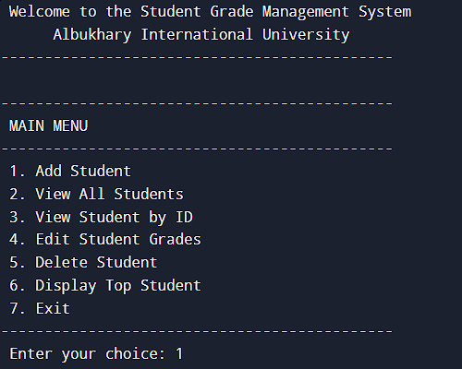
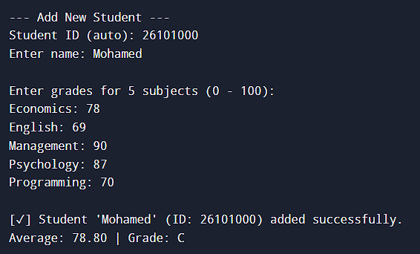
Sample Output — What the Program Displays
Main Menu
View Average & Grade
IDs auto-increment from 26101000. Grades are clamped 0–100. Average and letter grade are computed instantly on entry.

Slide 11
Conclusion
✦
Uses typedef struct to group all student data into one clean type
✦
Global array + totalStudents counter acts as the in-memory database
✦
findStudent() enables fast ID-based lookup for view, edit, and delete
✦
computeAverage() and getLetterGrade() keep calculations consistent
✦
Input validation clamps all grades to the valid 0–100 range
✦
deleteStudent() keeps the array gap-free by shifting elements left

